Slide 1
<Basic System Context Diagram>
Card
PTS
Control
Sensor
Monitor
Card Reader
Digital Clock

Slide 2
<System Context Diagram>
Card
update
PTS
Control
Sensor
Card info input
display
Monitor
Adjust stat
recording
Company
Card Reader
Digital Clock

Slide 3
DFD lv 0
Card
update
Card info input
PTS
Control
0
Sensor
display
Monitor
Adjust stat
recording
Company
Card Reader
Digital Clock

Slide 4
DFD lv 1
Card
update
Card Info load
1
PTS
Control
2
Sensor
CID, CRID
Card Info
display
Monitor
recording
Card Reader
state
Digital Clock
Adjust stat
Catch Adjust
3
Company

Slide 5
DFD lv 2
Card Reading Interface
1.1
Card Info load
1.2
Sensor
Signal
CID, CRID
Card Info
Catch Adjust
Interface
3.1
Adjust state
Catch Adjust
3.2
state
Company
Signal2
Display interface
2.2
Display data
display
Monitor
Card Info
Payment
Control
2.1
Card data
Card
Interface
2.3
update
Card
state
Card Reader
data
Card Reader recording
Interface
2.4
record
Card Reader
Digital Clock

Slide 6
DFD lv 3
Result
2.1.4
Display data
Display data
Display data
Enable
Updated Card Info
CRID
Disable
Catch error control 2.1.1
Card Info
CRID
Money check
Control
2.1.2
Payment
Controller
2.1.3
Card update
2.1.5
Card Info
trigger
Card data
state
trigger
Card Reader Record
2.1.6
Card Reader
data
Digital Clock

Slide 7
DFD lv 4
Catch Error
2.1.1.2
Display data
Trigger
Catch Error Controller 2.1.1.1
Card Info
Display data
Enable
state
Disable
Fix Price
2.1.1.3
Catch Short
2.1.2.2
Trigger
price
Calculation
2.1.2.3
Payment Controller 2.1.3
Updated data
Money Check Controller 2.1.2.1
Enable
Disable

Slide 8
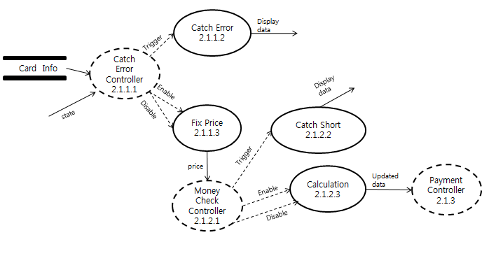

Slide 9
Payment Controller
/enable “Result”
Result
Tick[record== true]
/disable “Card Reader Record”
Enable “Result”
Tick[update == true]
/disable “Card Update”
Enable “Result”
/disable “Result”
Trigger “Card Update”
/disable “Result”
Trigger “Card Reader Record”
Card Update
Card Reader Record

Slide 10
Catch Error Controller
Catch Error
/Trigger “Catch Error”
Tick[state == Nomal]
/disable “Catch Error”
Trigger “Fix price”
Tick[state != Nomal]
/disable “Fix price”
Trigger “Catch Error”
Fix Price

Slide 11
Money Check Controller
Catch Short
/Trigger “Catch Short”
Tick[state==Nomal]
/disable “Catch Short”
trigger “Calculation”
Tick[state == Nomal]
/disable “Calculation”
enable “Catch Short”
Calculation

Slide 12
Sensor
Error
2.1.1.2
Card Info
Trigger
Display data
Signal
Catch error controller 2.1.1.1
Display interface
2.2
display
Monitor
Card Reading Interface
1.1
Adjust stat
Disable
Display data
Enable
CID, CRID
Company
Fix price
2.1.1.3
Display data
Result
2.1.4
Card
Card Info load
1.2
price
update
Short
2.1.2.2
Card
Interface
2.3
Money check controller 2.1.2.1
Trigger
Enable
Disable
Enable
Card Reader
Payment controller 2.1.3
Card data
Disable
Calculation
2.1.2.3
Updated data
Card update
2.1.5
record
trigger
trigger
Card Reader Record
2.1.6
Card Reader
data
Card Reader recording
Interface
2.4
Digital Clock

Slide 13
Sensor
Company
Monitor
Card
Card Reader
Signal
Signal2
display
update
record
Card Reading Interface
1.1
Catch Adjust
Interface
3.1
Display interface
2.2
Card Reader recording
Interface
2.4
Card
Interface
2.3
CID, CRID
Adjust state
Card data
Card Reader data
Card Info Load
1.2
Card Info Load
1.2
Card Reader Record
2.1.6
Card update
2.1.5
Display data
Display data
Display data
state
Catch Error
2.1.1.2
Short
2.1.2.2
Result
2.1.4
Card Info
Trigger
Trigger
Trigger
Trigger
Enable
Catch Error Controller 2.1.1.1
Fix Price
2.1.1.3
Money Check Controller 2.1.2.1
Calculation
2.1.2.3
Disenable
Payment controller 2.1.3
Enable
price
Enable
Updated data
Disable
Disable
Digital Clock

Slide 14
Card Reading Interface
1.1
CID,
CRID
Card Info load
1.2
Sensor
Signal
Card Info
Catch error controller 2.1.1.1
Catch Adjust
Interface
3.1
Adjust state
Catch Adjust
3.2
state
Company
Signal2
Trigger
Disable
Fix price
2.1.1.3
Catch Error
2.1.1.2
price
Short
2.1.2.2
Money check controller 2.1.2.1
Trigger
Enable
Disable
Calculation
2.1.2.3

